Slide 1
SOEN 384
Management, Measurement and Quality Control http://users.encs.concordia.ca/~s384_2/
Instructor: Dr. Olga Ormandjieva
Lecture 1:
Course Overview

Slide 2
Agenda for today
Course roadmap
CEAB graduate attributes
Course goal and objectives
Course assumptions
SWEBOK
Definition of Software Measurement.
Homework 1
Next?
SOEN384-F15-L1: Introduction

Slide 3
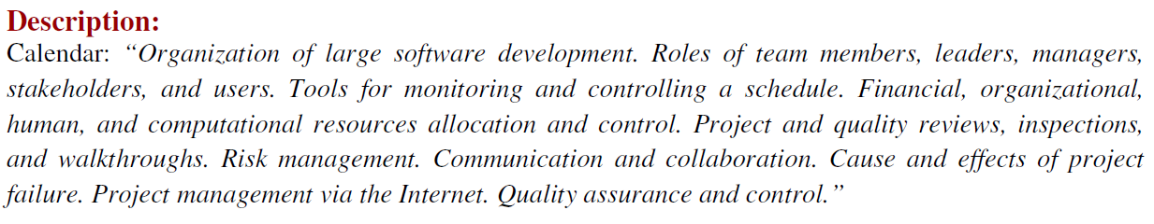
Soen384 – Fall 2015
Course webpage: http://users.encs.concordia.ca/~s384_2/
SOEN384-F15-L1: Introduction

Slide 4
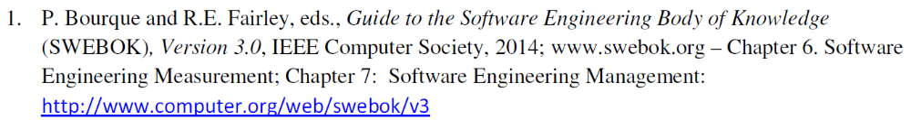
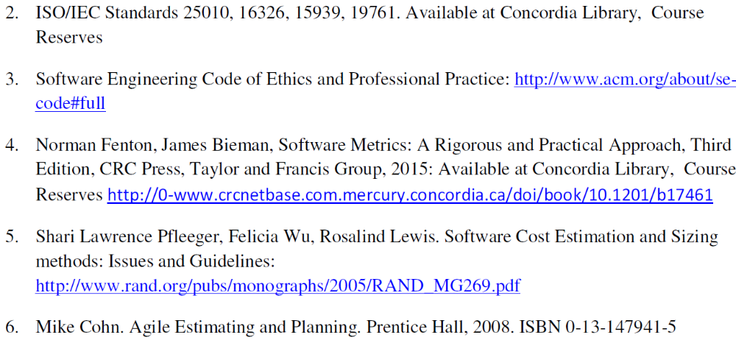
References
SOEN384-F15-L1: Introduction

Slide 5
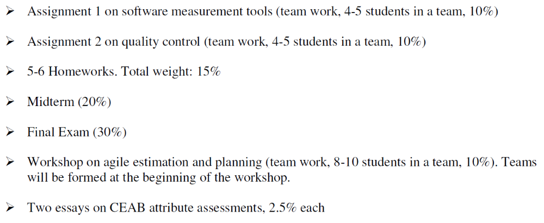
Grading & Deliverables
SOEN384-F15-L1: Introduction

Slide 6
communication
Course mailing list:
  soen384-f15 at cse.concordia.ca
Email all questions related to teaching. marking and organization of the course to the instructor, the TAs & markers here:
priv-soen384-f15 at cse.concordia.ca
SOEN384-F15-L1: Introduction

Slide 7
Tutorials
First tutorial on Friday, September 18
  -FA-- 09:00 -- 10:05 (H929)
  -FB-- 09:00 -- 10:05 (H905)
SOEN384-F15-L1: Introduction

Slide 8
More on the course
Password-protected material
How to study for this course
  Slides outline the structure of the course topics and coverage
  Read the corresponding reference material
    Posted on the course webpage
  Do homework, exercises, assignments
Office hours
  Thursdays 4pm-5pm o by appointment
SOEN384-F15-L1: Introduction

Slide 9
Agenda for today
Course roadmap
CEAB graduate attributes
Course goal and objectives
Course assumptions
SWEBOK
Definition of Software Measurement.
Homework 1
Next?
SOEN384-F15-L1: Introduction

Slide 10
Canadian Engineering Accreditation Board’s graduate attributes to be evaluated in this course
Knowledge-base
Investigation
Use of engineering tools
Communication skills
Economics and project management
Professional ethics and accountability
Professional practice
SOEN384-F15-L1: Introduction

Slide 11
CEAB graduate attributes’ Learning Objectives
Economics and project management , Project planning and implementation
  Develop work breakdown structure.
  Develop project schedules.
  Identify critical paths.
  Identify and manage risk.
  Build teams and manage team dynamics.
  Adjust schedule of tasks and resources.
  Monitor budget and schedule.
  Use active risk mitigation strategies.
  Calculate earned value.
  Measure and analyze project quality.
  Identify root causes of project failure.
  Determine customer satisfaction.
SOEN384-F15-L1: Introduction

Slide 12
CEAB graduate attributes’ Learning Objectives
Knowledge-base:
Competence in engineering fundamentals in software measurement, project management and quality control
Investigation:
  Use proper tools to do the measurements.
  Report data objectively.
  Use statistics to analyze and interpret data.
  Synthesize information to arrive at substantiated conclusions and/or iterate on the investigation.
Use of engineering tools
Demonstrate appropriate operational use of tools (e.g. software) for specific tasks in a laboratory environment.
Communication skills
  Organize information appropriately for readers’ use
  Use correct language and diagrams to clearly and efficiently convey complex information
  Use of appropriate templates and documentation standards
SOEN384-F15-L1: Introduction

Slide 13
CEAB graduate attributes’ Learning Objectives
Professional ethics and accountability
  Distinguish professional ethics from ethics in Canada and Quebec
  Identify duties and obligations in the Professional/Engineer’s code
  Apply professional ethics in case studies
  Describe accountability to multiple constituencies: engineering profession, public, client
  Apply accountability to professional context
Professional practice
  Communicate through accepted professional means
  Identify relevant professional standards
SOEN384-F15-L1: Introduction

Slide 14
Agenda for today
Course roadmap
CEAB graduate attributes
Course goal and objectives
Course assumptions
SWEBOK
Definition of Software Measurement.
Homework 1
Next?
SOEN384-F15-L1: Introduction

Slide 15
Software Project Management Goal (and soen384 goal)
To integrate measurement-based software project management processes with the underlying business and technical processes in order to develop high-quality products in predictable ways
SOEN384-F15-L1: Introduction

Slide 16
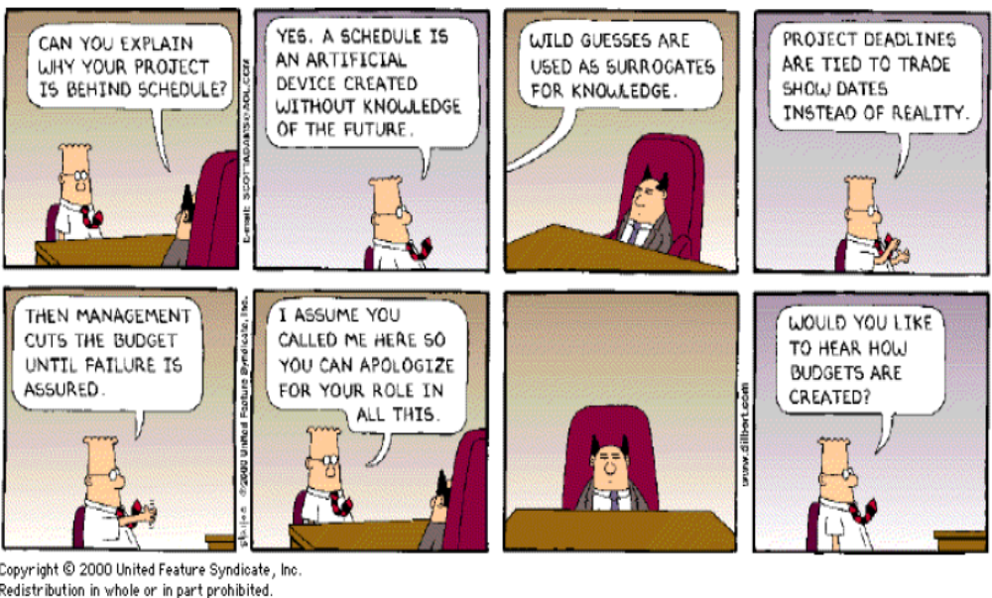
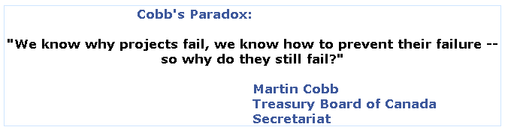
Martin Cobb’s Paradox …
SOEN337-Week1: Introduction

Slide 17
Some of the objectives of the course: to develop ...
An understanding of the estimation methods
The ability to properly apply project management methods to the requirements, architecture, design, testing, and delivery of software products
The ability to monitor and to report on the status of software development work
The ability to use reviews and assessments effectively
The ability to minimize risk
The ability to tailor the project management processes to appropriately match the project and its environment
The ability to review successes and failures and to lean from our experiences.
A broad understanding of how project management can be applied to software development projects
SOEN384-F15-L1: Introduction

Slide 18

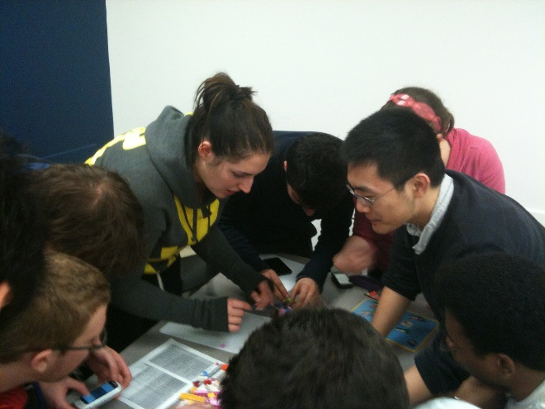
What is a Software-based Development Project?
A set of tasks performed by people with assistance from a variety of tools, computers, compilers, software development environments, test equipment, etc.
a set of processes that connect those tasks in order in which the tasks must be accomplished
Constraints: scope, schedule, budget, quality
Specific characteristics:
  It is extremely difficult to look at a piece of software and to know the status of the work involved in developing it.
  Creates a unique product or service
  Different team dynamics
  …
SOEN384-F15-L1: Introduction

Slide 19
What software development project managers typically do?
Understand the business needs
Understand the constraints (budget, schedule, scope, volatility of requirements ... )
Negotiate a commitment (scope, schedule, budget, resources)
Lead in planning
  Identify every task, define the tasks, allocate resources to tasks, schedule tasks, and assign responsibility for completion of tasks for the overall project.
  Clearly define and manage the definition of interfaces (technical and interpersonal communication)
Communicate goals, plans, project status, and changes to all of the stakeholders.
Execute the plan by monitoring the status and identifying discrepancies between the plan and the status, and addressing issues
SOEN384-F15-L1: Introduction

Slide 20
Some course assumptions
(the material has to be tailored to other environments)
Life cycle models and development processes
  Waterfall
  Spiral
  Agile
Team size 10-20 people in average
New development
SOEN384-F15-L1: Introduction

Slide 21
Agenda for today
Course roadmap
CEAB graduate attributes
Course goal and objectives
Course assumptions
SWEBOK
Definition of Software Measurement.
Homework 1
Next?
SOEN384-F15-L1: Introduction

Slide 22
Software Engineering Management Subareas (SWEBOK)
Software project management process (5 subareas)
  Management process refers to the activities that are undertaken in order to ensure that the software engineering processes are performed in a manner consistent with the organization’s policies, goals, and standards.
Software engineering measurement (1 subarea)
  Measurement refers to the assignment of values and labels to aspects of software engineering (products, processes, and resources ) and the models that are derived from them, whether these models are developed using statistical or other techniques.
SOEN384-F15-L1: Introduction

Slide 23
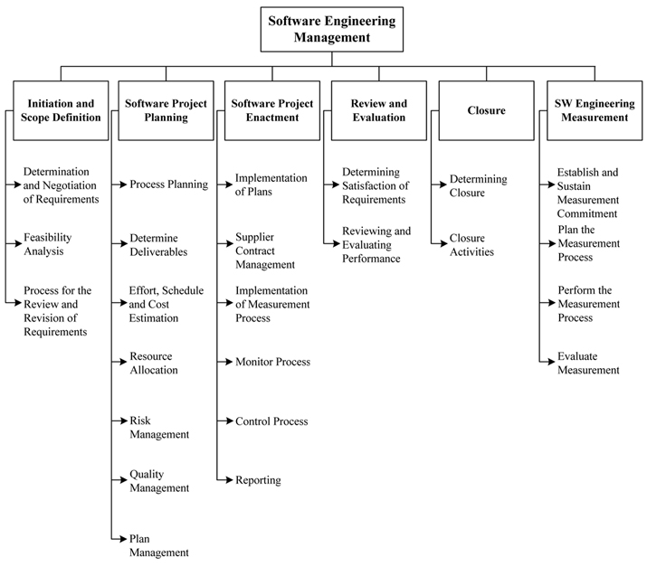
BREAKDOWN OF TOPICS FOR SOFTWARE ENGINEERING MANAGEMENT: SWEBOK
SOEN384-F15-L1: Introduction
Notes:
Primary basis for the top-level breakdown is the process of managing a software engineering project.

Slide 24
Software Engineering Management Subareas (SWEBOK)
Software project management process (5 subareas)
Software engineering measurement (1 subarea)
Why two different subjects (management and measurement) are combined?
  Management without measurement, qualitative and quantitative, suggests a lack of rigor
  measurement without management suggests a lack of purpose or context.
SOEN384-F15-L1: Introduction

Slide 25
Why measurement?
Project Cost-Benefits Analysis
and Planning
Requirements Capture
Analysis & Design
Implementation
Test
Measurement Feedback
Prepare Release
Customer satisfaction
SOEN384-F15-L1: Introduction
Notes:
Feedback’s intrinsic flaw isn’t in the medium or the message — it’s in the metrology. Feedback must be explicitly linked to metrics, measures, and mechanisms that track the desired — and desirable — change. Feedback that comes without ways to monitor measurable change is less meaningful feedback than it is well-intentioned advice. In other words, effective feedback requires effective feedback.
More precisely, measurement goal is to identify anomalies within the same development phase in which it originated, as well as to measure progress

Slide 26
Course Topics by Areas
Part I: Software Measurement
Part II: Software Project Management
Part III: Agile Estimating and Planning.
SOEN384-F15-L1: Introduction

Slide 27
What is Measurement?
in every-day life
  Medicine: thermometer, scale, X-Ray, etc.
  Education: marks, GPA
in engineering disciplines
  Civil engineering: relation between materials (such as concrete, bricks, etc) and temperature; behavior under extreme conditions (earthquakes), etc.
  …
SOEN384-F15-L1: Introduction

Slide 28
What is Measurement?
Measurement is the process by which numbers or symbols are assigned to things in the real world in such a way as to characterize (interpret) them according to clearly defined rules.
SOEN384-F15-L1: Introduction

Slide 29

Everyday life examples:
Temperature Measurement (add tool) and Body of Knowledge
Measurement of Temperature
Real World Things
Numbers
Interpretation of the result
SOEN384-F15-L1: Introduction

Slide 30
How does temperature measurement relate to software measurement?
Example: Lines Of Code (LOC)
Measurement of LOC
Code
Numbers
Interpretation of the result
SOEN384-F15-L1: Introduction

Slide 31
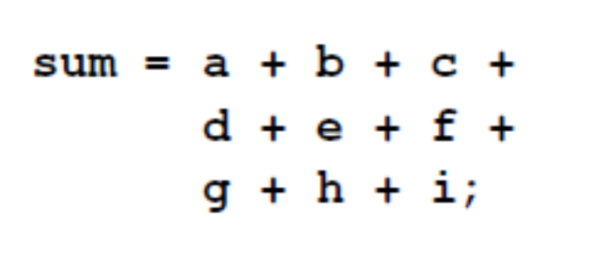
Classical example of measurement: Code Length
Physical LOC [corresponds] to one line starting with the first character and ending by a carriage return or an end-of-file marker of the same line, and which excludes the blank and comment line.
Physical SLOC?
SOEN384-F15-L1: Introduction

Slide 32
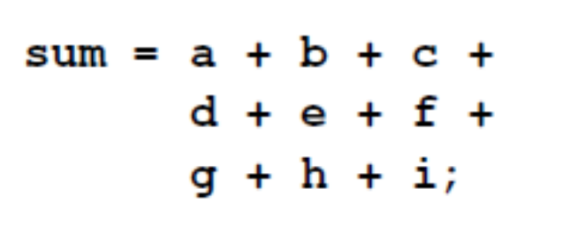
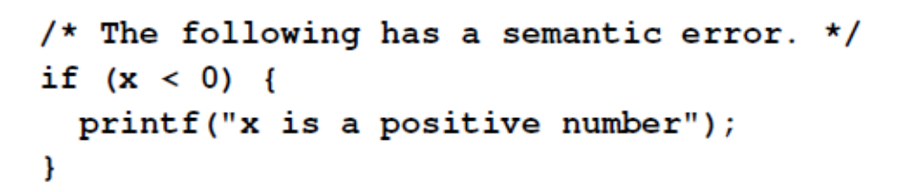
Classical example of measurement: Code Length (2)
Logical LOC is given by the number of “statements” in a program
  Language dependent!
  => the counting of logical LOC is ambiguous
SLOC?
SOEN384-F15-L1: Introduction

Slide 33
Homework 1 (2%)
What to measure: CODE’s LEGTH
Measurement method: logical SLOC
Goal: to understand the importance of clearly defined rules in measurement
Tasks (next)
SOEN384-F15-L1: Introduction

Slide 34
Homework 1 (2%, individual)
Due on Sept. 16th by midnight, submit electronically (EAS) as "Proposal 1"
Read the document LENGTH OF SOURCE CODE BY Dr. PANKAJ KAMTHAN
Write a program to calculate the distance between two gps coordinates using latitude and longitude in radians in a programming language of your choice
Record the time [in minutes] it took you to write the program.
Calculate the logical SLOC (source lines of code):
  Manually
  Automatically, using two different size measurement tools of your choice.
Compare the differences, interpret the results (are the results identical? If not, why? Which tool is more reliable for collecting SLOC data?)
SOEN384-F15-L1: Introduction

Slide 35
Questions?
...
SOEN384-F15-L1: Introduction

Slide 36
Next?
Lecture 2: Classical measurements. Software measurement tools.
There is no tutorial this week!
SOEN384-F15-L1: Introduction

